Slide 1
6.0 Non-sinusoidal Waveforms
Fourier Analysis
EE1203 – Theory of Electricity
Prof J. Rohan Lucas
lucas@kdu.ac.lk
Department of Electrical, Electronic & Telecommunication Engineering
General Sir John Kotelawala Defence University
October 2020
Notes:
The next lecture is on non-sinusoidal waveforms. This will be studied under two sections, namely Fourier Series dealing with non-sinusoidal periodic waveforms, and Laplace Transform which will deal with non-repetitive waveforms.

Slide 2
Learning Outcomes
On completion of module, student will be able to
LO1: Analyse the performances of AC circuits
Analyse circuits using nodal and mesh theory
LO2: Analyse two port networks using different models.
LO3: Analyse transfer functions of RLC networks for transients.
LO4: Analyse waveforms for its harmonics.
LO5: Perform calculations in three phase circuits including unbalanced waveforms.
t
Notes:
.The lectures on Fourier Series comes under the learning outcome LO4 which deals with the analysis of waveforms for its harmonics.

Slide 3
Non-Sinusoidal Waveforms – Fourier Analysis
Simple Waveforms
You are now familiar with direct waveforms and sinusoidal alternating waveforms
a(t)
a(t)
a(t) = A_{m} sin(ωt+θ)
a(t) = A
t
t
Figure 1(a) – direct waveform
Figure 1(b) – sinusoidal waveform
Notes:
You are now familiar with direct waveforms and sinusoidal alternating waveforms
The pure direct waveform has a constant value independent of time and has a mean value “A”, while the pure sinusoidal waveform varies sinusoidally with time, has a zero mean value, a peak value of Am, an angular frequency of omega, and a phase angle of theta as shown.

Slide 4
Other Waveforms
a(t)
a(t)
a(t)
T
a(t)
t
t
t
t
(a)
(b)
(c)
(d)
(a), (b), (c) and (d) are uni-directional, although not purely direct.
a(t)
T
a(t)
T
t
t
(e)
(f)
(e) and (f) are repetitive with zero mean value,
a(t)
a(t)
a(t)
t
t
t
(g)
(h)
(i)
(c), (h) and (i) are repetitive waveforms with finite mean values
Notes:
Before starting on the Fourier series, let us try to understand different types of waveforms.
Waveforms (a), (b), (c) and (d) are uni-directional, although not purely direct, while waveforms (e) and (f) are repetitive with zero mean value. On the otherhand, waveforms (c), (h) and (i) are repetitive waveforms with finite mean values.

Slide 5
a(t)
Basically two groups of waveforms
non-repetitive
(will be dealt with under Laplace Transform)
repetitive
Repetitive waveform
only one period “T” needs to be defined
can be broken up to a fundamental component (corresponding to period T) and its harmonics.
uni-directional term (direct component) may exist.
t
a(t)
t
T
Notes:
With Fourier analysis, we will only be dealing with repetitive waveforms, whether they have mean values or not. Non repetitive waveforms will be dealt with under Laplace transform in a later lecture.
For the repetitive waveform, only one period “T” needs to be defined.
It can be broken up to a fundamental component (corresponding to period T, or frequency f or angular frequency omega) and its harmonics.
Uni-directional term (direct component) may exist.

Slide 6
Fourier Series
Named after French mathematician (1822).
ω_{o} = 2π/T
f(t) = F_{o} + F₁ cos (ω_{ο} t+θ₁) + F₂ cos (2ω_{ο} t+θ₂) + F₃ cos (3ω_{ο} t+θ₃) + F₄ cos (4ω_{ο} t+θ₄) + F₅ cos (5ω_{ο} t+θ ₅) +…………
f(t) = A_{o}/2 + A₁ cos ω_{ο} t + A₂ cos 2ω_{ο} t + A₃ cos 3ω_{ο} t + A₄ cos 4ω_{ο} t
+ …………+ B₁ sin ω_{ο} t + B₂ sin 2ω_{ο} t + B₃ sin 3ω_{ο} t + ……
Notes:
The Fourier series is named after the French mathematician who formulated the series in 1822. It is a way of representing a periodic function as an infinite series of sinusoidal functions having integer multiple frequencies. It can also be represented by an infinite sum of sine and cosine functions, with a direct component, as shown.

Slide 7
Symmetry in Waveforms
Many periodic waveforms exhibit symmetry.
Use of symmetry helps reduce tedious calculations
  Even symmetry
  Odd symmetry
  Half-wave symmetry
Notes:
Many periodic waveforms exhibit symmetry which may be made use of in simplifying the determination of the coefficients of the Fourier series.
These are Even symmetry, Odd symmetry, and Half-wave symmetry, all of which will be explained in detail in the following slides.

Slide 8
Even Symmetry f(t) = f(-t)
Region before y-axis is mirror image of region after y-axis.
a(t)
a(t)
a(t)
t
t
t
(a)
(b)
(c)
a(t)
a(t)
a(t)
t
t
t
(d)
(e)
(f)
Figure 3 –Waveforms with Even symmetry
Notes:
Let us consider first even symmetry. This is like drawing the right half of a person and holding it against a mirror to complete the missing part of the image. Likewise, a waveform with even symmetry will have the half of the waveform on the negative side of the axis the mirror image of that on the positive side of the axis as shown in the figures.

Slide 9
a(t)
Simplest waveforms with even symmetry
cosine waveform – figure (a)
direct waveform – figure (b).
Even symmetry can exist in both periodic and non-periodic waveforms.
Both direct terms as well as varying terms can exist in such waveforms.
If waveform is defined for only t ≥ 0,
the remainder is automatically known by symmetry.
t
(a)
a(t)
t
(b)
Notes:
The simplest form of alternating waveform having even symmetry is the cosine waveform shown in figure (a), while the direct waveform of figure (b) also has even symmetry.
Even symmetry can exist in both periodic and non-periodic waveforms.
Both direct terms as well as varying terms can exist in waveforms with even symmetry.
If waveform is defined for only for the positive half, that is t greater than or equal to zero,
the remainder can automatically be obtained by symmetry.

Slide 10
Odd Symmetry f(t) = (-) f(-t)
Region before y-axis is negative of mirror image of region after y-axis
a(t)
a(t)
a(t)
t
t
t
(a)
(b)
(c)
a(t)
a(t)
a(t)
t
t
t
(d)
(e)
(f)
Figure 4 – Waveforms with Odd symmetry
Notes:
Let us next consider odd symmetry. This is like drawing the right half of a waveform and then creating the negative half by taking a mirror image of the negated right side. Such waveforms are shown in the figures.

Slide 11
Simplest waveforms with odd symmetry
sine waveform – figure (a)
ramp waveform – figure (b).
Odd symmetry can exist in both periodic and non-periodic waveforms.
However, only varying terms can exist in such waveforms.
Direct terms cannot exist in odd waveforms.
If the waveform is defined for only t ≥ 0,
the remainder is automatically known by symmetry.
a(t)
t
(a)
a(t)
t
(b)
Notes:
The Simplest alternating waveform with odd symmetry is the sine waveform shown in figure (a), while the simplest non-repetitive waveform is the ramp waveform shown in figure (b). However, figure (b) cannot be included in the Fourier series.
Odd symmetry can exist in both periodic and non-periodic waveforms.
However, only varying terms can exist in such waveforms and a direct term is not possible.
If the waveform is defined for only time greater than zero, the remainder is automatically known by symmetry.

Slide 12
Decomposition into odd and even functions
Waveforms in general need not be either odd or even.
They can be split into a combination of odd and even.
Let f(t) = f_{odd}(t) + f_{even}(t)
Then f(-t) = f_{odd}(-t) + f_{even}(-t) = - f_{odd}(t) + f_{even}(t)
Addition and subtraction thus gives
and
verifying the assumption
Notes:
Waveforms in general need not be either odd or even, but can be split into a combination of odd and even. This can be verified as follows.
Let us assume that the function f(t) can be made up of the summation of f_{odd}(t) and f_{even}(t)
Then f(-t) can be calculated as f_{odd}(-t) + f_{even}(-t) or - f_{odd}(t) + f_{even}(t)
Addition and subtraction thus gives
f odd (t) equals half the difference between f(t) and f(-t), while f even (t) is composed of half the sum of f(t) and f(-t)
This veries that any general waveform can be split into a combination of odd and even waveforms paving the way for the Fourier series to be made up of direct terms, cosine terms and sine terms.

Slide 13
Half-wave Symmetry
A function f(t) exhibits half-wave symmetry, when one half of waveform is exactly equal to the negation of previous or next half of waveform.
i.e.
a(t)
a(t)
a(t)
t
t
t
(a)
(b)
(c)
Figure 5 – Waveforms with Half-wave symmetry
Notes:
While both even waveforms and odd waveforms depend on the origin and the positive and negative sides of the axis, half wave symmetry is not dependent on the position of the axis.
A function f(t) exhibits half-wave symmetry, when one half of waveform is exactly equal to the negation of previous or next half of waveform as shown.

Slide 14
The simplest form of Half-wave Symmetry is sinusoidal waveform in figure (a).
Half-wave symmetry can only exist in periodic waveforms.
Only varying terms can exist in such waveforms.
Direct terms cannot exist in half-wave symmetrical waveforms.
If the waveform is defined for only one half cycle, not necessarily starting from t=0, the remaining half of the waveform is automatically known by symmetry.
a(t)
t
(a)
Notes:
The simplest form of Half-wave Symmetry is the sinusoidal waveform shown in figure (a). You will notice that it need not be a sine waveform or a cosine waveform, but can have any phase angle.
Half-wave symmetry can only exist in periodic waveforms.
Only varying terms can exist in such waveforms.
Direct terms cannot exist in half-wave symmetrical waveforms.
If the waveform is defined for only one half cycle, not necessarily starting from t=0, the remaining half of the waveform can automatically be determined by symmetry.

Slide 15
Some useful Trigonometric Properties
with ω_{ο} T = 2π
for all values of m and n
Notes:
Let me recall for you some of the basics that you have learnt in trigonometry that will be useful in determining the Fourier coefficients.
The area under one cycle of a sinusoidal waveform is zero, whether cosine, or sine or any other phase angle. Thus if a complete number of cycles are completed within a given period, then the integral of that waveform is also zero.
Since the product of sine and cos, or sine and sine, or cos and cos yields sinusoidal waveforms, unless the frequency and phase angle of the two terms are equal, the above expressions can be shown to be true.

Slide 16
Evaluation of Coefficients A_{n} and B_{n}
First term of Fourier Series is written as A_{o}/2 rather than A_{o}.
–3ω_{o} –2ω_{o} – ω_{o} 0 ω_{o} 2ω_{o} 3ω_{o} ω
Negative half ← → Positive half
Zero belongs equally to positive half and negative half.
gives only ½A_{o} for positive half
evaluated with same general expression for A_{n}, n = 0.
A_{o}/2 also corresponds to direct component of waveform.
Notes:
Our main quest is to obtain the coefficients of the terms in the Fourier series. Let us examine how that can be done.
As we saw earlier, the Fourier series of a periodic function f(t) is defined as the sum of a direct term A zero by 2 plus the sum from 1 to infinity of An cos n omega t plus Bn sin n omega t.
You might wonder why the first term is written as A zero by 2 rather than A0. This is because mathematically the same expression can be used to calculate both A0 and An.
I will explain logically why that happens.
Consider the x-axis, or in this case the omega axis. It goes from minus infinity in the left to plus infinity in the right.
When we look at sin omega t or cos omega t, we can see that minus sin minus omega t and cos minus omega t have the same values as those with positive angular frequency. Thus it is not feasible to mathematically separate a positive frequency from a negative frequency. Thus frequency must be limited to the positive values.
If you again look at the axis, you will see that zero frequency or direct value, does not really belong to either the positive side or the negative side, but in between. Or in other words we can say that half of zero mathematically belongs to the positive side and half to the negative side.
That is why A zero appears as A zero by 2 in the Fourier series. This is not a proof but an explanation to help you to visualise.

Slide 17
using properties of trigonometry, only first term gives non zero integral.
i.e.
or mean value =
gives same result for A_{o}.
Notes:
Let us now integrate f(t) with respect to t, and also its Fourier series, as shown.
Using the properties of trigonometry which we recently recalled, only first term gives a non zero integral.
This gives A zero equal to two over T integral over one complete cycle from any t zero of f(t).
The mean value of f(t) is one over T integral over one complete cycle from any t zero of f(t), or half the integral for A zero.
Thus half A zero can also be determined by determining the mean value.

Slide 18
To determine remaining values of A_{n},
multiply each term by cos mω_{o}t and integrate.
using properties of trigonometric functions,
only cos nω_{o}t term on right hand side of equation will give a non zero integral, and that too only when m=n.
Notes:
In a similar manner, to determine the coefficient An can be determined by each term by cos m ομεγ ζερο t before integrating.
In this integral too, only cos n omega zero t term on right hand side of equation will give a non-zero integral, and that too only when m=n.
Thus An may be determined as two over T integral over any complete cycle of f(t) times cos n omega zero t, and Bn as two over T integral over any complete cycle of f(t) times sin n omega zero t.

Slide 19
Analysis of Symmetrical Waveforms
Even Symmetry
f(t)
−T/2
T/2
t
T
Figure 6 – Analysis of even waveform
0 to T/2 corresponds to mirror image from –T/2 to 0.
Notes:
Let us now see how the symmetrical properties of waveforms may be made use of to reduce the complexity of calculation of the Fourier coefficients.
First let us consider a waveform with even symmetry as shown in the figure.
It is to be noted that the waveform from 0 to T/2 corresponds to the mirror image from –T/2 to 0.

Slide 20
Consider period from −T/2 to T/2 for integration.
In first part of expression, ‘t’ is replaced by ‘−t’
Since function is even,
f(−t) = f(t), and cos(−nω_{ο}t) = cos(nω_{ο}t).
Notes:
Since symmetry for an even function is across the y-axis, consider a period from minus half T to plus half T. This may then be split into two regions from minus half T to zero, and from zero to plus half T.
Then using the mathematical properties of change of variable from In first part of expression, ‘t’ is replaced by ‘−t’ in the first part of expression, the two integrals can be seen to be similar.
Since function is even, f(−t) = f(t), and cos(μινυσ n omega zero t) = cos(n ομεγα ζερο t)

Slide 21
Thus equation simplifies to
Interchanging upper and lower limits of first integral removes negative sign in front of first integral.
Thus
Notes:
Although I have shown the mathematics step by step, I am not going to read them out.
Simplification yields the result that An equals twice the integral over half a cycle starting from zero.
We may use similar simplification to simplify Bn

Slide 22
f(−t) = f(t), and sin(−nω_{ο}t) = − sin(nω_{ο}t).
The two integrals are equal in magnitude but have opposite signs so that they cancel out on addition.
For waveforms with even symmetry, B_{n} = 0 for all n
A_{n} is calculated as twice integral over half cycle from zero.
Can only have cosine terms and a direct term.
where
Notes:
When simplying you will realise that although the two integrals have equal magnitude, they have opposite signs.
Thus for waveforms with even symmetry, B_{n} = 0 for all n and A_{n} is calculated as twice integral over half cycle from zero.
Waveforms with even symmetry can only have cosine terms and a direct term.

Slide 23
Odd Symmetry
f(t)
−T/2
T/2
t
T
Figure 7 – Analysis of odd waveform
0 to T/2 corresponds to negated mirror image of waveform from –T/2 to 0.
Notes:
Let us now see how the symmetrical properties of waveforms may be made use of to reduce the complexity of calculation of the Fourier coefficients.
Let us now consider a waveform with odd symmetry as shown in the figure.
It is to be noted that the waveform from 0 to T/2 corresponds to the negated mirror image from –T/2 to 0.

Slide 24
Consider period from −T/2 to T/2 for integration.
f(t) = − f(−t)
In first part of expression, ‘t’ is replaced by ‘−t’.
Notes:
Integration is again split into two parts, from minus half T to zero and from zero to half T.
Mathematics is similar to the earlier case. Thus no more explanation will be made as it is easy to follow.

Slide 25
i.e. A_{n} = 0 for all n for odd waveform
With a similar derivation, it can be shown that

Slide 26
Thus for waveforms with odd symmetry
A_{n} = 0 for all values of n
B_{n} is calculated as twice integral over half cycle from zero.
Can only have sine terms and no direct term
where
Notes:
Thus for waveforms with odd symmetry
A_{n} = 0 for all values of n
B_{n} is calculated as twice integral over half cycle from zero.
Also, a B zero term cannot exist.

Slide 27
Half-wave Symmetry
f(t)
Half-cycle from (t_{o}+T/2) to (t_{o}+T) corresponds to negated value of previous half cycle from t_{o} to (t_{o}+T/2)
t
T
Figure 8 – Analysis of waveform with half wave symmetry
Notes:
Next let us consider the case of half wave symmetry as shown in the figure. The waveform has no relationship to the y-axis, but to the successive positive and negative half cycles.
The Half-cycle from (t_{o}+T/2) to (t_{o}+T) corresponds to negated value of previous half cycle from t_{o} to (t_{o}+T/2)

Slide 28
In second part of expression ‘t’ is replaced by ‘t − T/2’.
f(t −T/2) = - f(t) for half-wave symmetry,
and since ω_{o}T = 2 π,
cos nω_{o}(t – T/2) = cos (nω_{o}t – nπ)
has a value of (–)cos nω_{o}t when n is odd, and
has a value of cos nω_{o}t when n is even.
Thus when n is odd
and A_{n} = 0 when n is even
Notes:
It is left for you to analyse the mathematics in this case.

Slide 29
Similarly
when n is odd
and B_{n} = 0 when n is even
With half-wave symmetry,
even harmonics do not exist
for odd harmonics both coefficients A_{n} and B_{n} can be obtained by taking double the integral over any half cycle.
Most practical waveforms have half-wave symmetry due to natural causes.
Notes:
Analysis shows that both An and Bn are zero with half wave symmetry when the harmonic number n is even, or explicitly stated, even harmonics do not exist.
For odd harmonics both coefficients A_{n} and B_{n} can be obtained by taking double the integral over any half cycle.
It is to be noted, that most practical waveforms have half-wave symmetry due to natural causes.

Slide 30
Summary for waveforms with symmetrical properties
1. With even symmetry,
B_{n} is 0 for all n,
A_{n} is twice integral over half a cycle from zero.
2. With odd symmetry,
A_{n} is 0 for all n,
B_{n} is twice integral over half a cycle from zero.
3. With half-wave symmetry,
A_{n} and B_{n} are 0 for even n,
A_{n} and B_{n} are twice the integral over any half cycle for odd n.
Notes:
Let us now summarize the simplifications that occur in the evaluation of the Fourier coefficients with symmetrical properties.
1. With even symmetry, B_{n} is 0 for all n, A_{n} is twice integral over half a cycle from zero.
2. With odd symmetry, A_{n} is 0 for all n, B_{n} is twice integral over half a cycle from zero.
3. With half-wave symmetry, A_{n} and B_{n} are 0 for even n, A_{n} and B_{n} are twice the integral over any half cycle for odd n.

Slide 31
4. With half-wave symmetry and either even symmetry or odd symmetry present,
A_{n} and B_{n} are 0 for even n,
four times integral over quarter cycle from time zero, for odd n for A_{n} or B_{n}
zero for the remaining coefficient B_{n} or A_{n}.
5. Note that in any waveform,
A_{o}/2 corresponds to mean value of waveform;
a symmetrical property may sometimes be obtained by subtracting mean value from waveform.
Notes:
4. With half-wave symmetry and either even symmetry or odd symmetry present, A_{n} and B_{n} are 0 for even n, four times integral over quarter cycle from time zero, for odd n for A_{n} or B_{n} , zero for the remaining coefficient B_{n} or A_{n}.
5. Note that in any waveform, A_{o}/2 corresponds to mean value of waveform;
a symmetrical property may sometimes be obtained by subtracting mean value from waveform.

Slide 32
Piecewise Continuous waveforms
Most practical waveforms are continuous and single valued (i.e. having a single value at any particular instant).
When sudden changes occur (such as in switching), or in square waveforms, near vertical lines could occur giving multi-value instants.
As long as these multi-values occur over finite bounds, the waveform is single-valued and continuous in pieces, or said to be Piecewise continuous.
Figure 9 –
Piecewise continuous waveform
Analysis can be carried out using the Fourier Series for both continuous or piecewise continuous waveforms.
Notes:
Most practical waveforms are continuous and single valued (i.e. having a single value at any particular instant).
When sudden changes occur (such as in switching), or in square waveforms, near vertical lines could occur giving multi-value instants.
As long as these multi-values occur over finite bounds, the waveform is single-valued and continuous in pieces, or said to be Piecewise continuous.
Analysis can be carried out using the Fourier Series for both continuous or piecewise continuous waveforms.

Slide 33
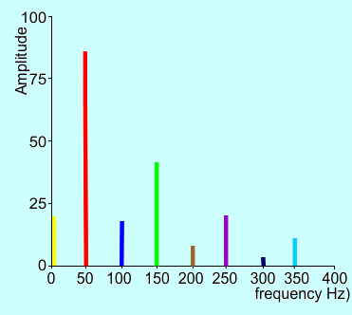
Line Frequency Spectrum
a plot showing d.c., fundamental, and each of harmonics (usually amplitude) against frequency.
values occur at distinct points
In practical waveforms,
higher harmonics usually have lower amplitudes
for smooth waveforms, high harmonics are negligible.
for piecewise continuous waveforms (such as square waveform) harmonics do not decrease very rapidly.
Notes:
Line Frequency Spectrum is a plot showing d.c., fundamental, and each of harmonics (usually amplitude) against frequency, with values occuring at distinct points.
In practical waveforms, higher harmonics usually have lower amplitudes
For smooth waveforms, high harmonics are negligible.
For piecewise continuous waveforms (such as square waveform) harmonics do not decrease very rapidly as near vertical lines correspond to very high frequencies.

Slide 34
Harmonic magnitude and phase angle
for n^{th} harmonic
Harmonic magnitude =
(positive value)
Harmonic phase angle =
Notes:
In the Fourier series, we have obtained the An and Bn coefficients. How do we combine these to obtain the harmonic magnitudes and phase angles.
Using trigonometry, it can easily be seen that the magnitude of each harmonic (nth) is determined as the square root of the sum of the squares of An and Bn. This is always a positive value.
Similarly the harmonic phase angle can be obtained as the inverse tan of Bn over An.

Slide 35
Example 1
Find the Fourier Series of the piecewise continuous rectangular waveform shown in figure 10.
a(t)
E
t
-3T/2
-T/2
0
T/2
3T/2
-E
Figure 10 – Rectangular waveform
Notes:
As an example, let us determine the Fourier series of the rectangular waveform shown, which obviously is piecewise continuous at the vertical edges.

Slide 36
Solution
Period of waveform = 2T
Mean value of waveform = 0.
∴ A_{o}/2 = 0
Waveform has even symmetry.
∴ B_{n} = 0 for all n
Waveform has half-wave symmetry.
∴ A_{n}, B_{n} = 0 for even n
∴ A_{n} can be obtained, for odd values of n,
as 4 times integral over quarter cycle as follows.
a(t)
E
t
-3T/2
-T/2
0
T/2
3T/2
-E
Notes:
It can be seen that the Period of waveform = 2T. Note, although the expression in the Fourier series has the period as T, in this example the period is 2T.
Mean value of waveform = 0, so that A zero by 2 = 0
It can easily be seen that the waveform has even symmetry giving rise to B_{n} = 0 for all n
and half-wave symmetry giving A_{n}, B_{n} = 0 for even n
Therefore, A_{n} can be obtained, for odd values of n, as 4 times integral over quarter cycle

Slide 37
for odd n
i.e. A₁ = 4E/π,
A₃ = −4E/3π,
A₅ = 4E/5π,
A₇ = −4E/7π, ...........
∴ a(t) =
Notes:
The mathematical simplifications are shown, yielding a general expression 4 E over n Pi times sin n Pi over 2.
By substituting different odd values of n, the coefficients A1, A3, A5 etc can be determined.
Do not try to evaluate An for even values of n, as any answer obtained will have to be multiplied by (1 minus 1) or zero and not (1 plus 1) or double.
The resulting series is seen to be a cosine series with alternate terms being plus and minus and each subsequent term decreasing inversely as its harmonic number.

Slide 38
Fourier Synthesis of Rectangular Waveform
t
Figure 11 shows synthesis of the rectangular waveform using the Fourier components obtained.
Notes:
In the waveforms shown, first the original rectangular waveform is shown, then only the fundamental has been plotted, then fundamental plus third harmonic, then corresponding to fundamental + third harmonic + fifth harmonic, then fundamental, third, fifth and seventh harmonics.
It can be seen that with addition of each harmonic component, the waveform approaches original waveform more closely, however without an infinite number of components it will never become exactly equal to original.

Slide 39
Frequency spectrum of Rectangular waveform
Amplitude
0 ω_{o} 2ω_{o} 3ω_{o} 4ω_{o} 5ω_{o} 6ω_{o} 7ω_{o} t
Figure 12 – Line Spectrum
Now consider what will happen to the spectrum if the rectangular waveform is shifted vertically and/or horizontally
Notes:
Frequency spectrum of the earlier rectangular waveform is shown.
Let us now see what will happen if the waveform is shifted horizontally or vertically. If the waveform is shifted horizontally, phase angles would change, while if shifted vertically a direct component would be added.

Slide 40
Example 2
b(t)
2E
t
Figure 13.
-5T/3
-T/3
0
2T/3
5T/3
-E
Find the Fourier series of the waveform shown in figure 13.
Solution
Waveform does not have any symmetrical properties, although it is virtually same waveform as in example 1.
Period = 2T, mean value = E/2
If E/2 is subtracted from the waveform b(t),
half wave symmetry is observed.
Notes:
Example 2 shows the rectangular waveform in example 1, being amplified one and half times from (–E and E) to from (-E to 2E) giving a non-zero mean value, and a horizontal shift of T by 6 making the waveform to be not even.
In its present form, Waveform does not have any symmetrical properties, although it is virtually same waveform as in example 1.
It can be seen that the Period = 2T, mean value = E/2
If E/2 is subtracted from the waveform b(t), half wave symmetry is observed.

Slide 41
If waveform is shifted by T/6 to left, even symmetry is observed.
Consider waveform
b₁(t) = b(t -T/6) - E/2, in figure 14
b₁(t) differs from waveform a(t) in figure 10 in magnitude only (1.5 times).
Thus b₁(t) can be obtained directly from earlier analysis.
b₁(t)
3E/2
t
-3T/2
-T/2
0
T/2
3T/2
-3E/2
Figure 14 – Modified waveform
∴ b₁(t) = 1.5×a(t) =
where ω_{o}2T = 2π
∴ b(t) = b₁(t +T/6) + E/2, also ω_{o}T/6 = π/6
Notes:
If waveform is shifted by T/6 to left, even symmetry is observed.
Now consider the modified waveform b₁(t) = b(t -T/6) - E/2 as shown.
b₁(t) differs from the waveform a(t) in the earlier problem in magnitude only (1.5 times).
Thus b₁(t) can be obtained directly from earlier analysis and given as shown.
Please note that without considering any earlier analysis, this waveform can be analysed from first principles.

Slide 42
b(t) =
If problem is worked from first principles the resultant would be same.
Amplitude
Figure 15 – Line Spectrum
0 ω_{o} 2ω_{o} 3ω_{o} 4ω_{o} 5ω_{o} 6ω_{o} 7ω_{o} t
Figure 15 shows the corresponding line spectrum.
Only differences from earlier are that amplitudes are 1.5 times higher and a d.c. term is present.
Notes:
The waveform b(t) is obtained by phase shifting and addition of the removed direct term as shown.
If problem is worked from first principles you would still obtain the same result.
The line spectrum of this waveform is also shown.

Slide 43
Example 3
Find Fourier Series of triangular waveform shown in figure 16.
Solution
Period of waveform = 2T, ω_{o}.2T = 2π
Mean value = 0. ∴ A_{o}/2 = 0
Has odd symmetry. ∴A_{n} = 0 for all n
Has half-wave symmetry. ∴A_{n}, B_{n} = 0 for even n
y(t)
E
t
-2T
-T
0
T/2
T
2T
-E
Figure 16 – Triangular waveform
=
for odd n
Notes:
Now let us consider how to determine the Fourier Series of the triangular waveform passing through the origin.
It is seen that the Period of waveform is again 2T so that ομεγα ζερο τιμεσ 2T = 2π Πι.
Αλσο ϖισυαλ οβσερϖατιον ωιλλ σηοω ψου τηατ τηε mean value is 0 so that A zero by 2 equals 0.
It can be seen that the waveform has odd symmetry so that A_{n} = 0 for all n
It also has half-wave symmetry so that even harmonics are absent and A_{n} and B_{n} are zero for even n.
Since there are two properties, odd symmetry and half-wave symmetry, Bn for odd harmonics can b determined by four times the integral over quarter cycle starting from 0. That is, from zero to T/2.

Slide 44
B_{n} =
B_{n} =
Substituting values
B₁ = 8E/π², B₃ = −8E/(3π)²,
B₅ = 8E/(5π)², B₇ = −8E/(7π)², ….
∴y(t) =
Notes:
Simplifying the mathematics, a general expression for Bn can be obtained as shown, and the individual values of the odd harmonics B1, B3, B5, B7 are evaluated as shown and the Fourier series may then be stated as y (t) equals 8E by Pi squared times sin omega zero t minus sin 3 omega zero t over 3 squared plus sin 5 omega zero t over 5 squared minus sin 7 omega zero t over 7 squared and so on.

Slide 45
Derivative of triangular waveform y(t)
Derivative of y(t),has waveform shown in figure 17.
This corresponds to same type of rectangular waveform in example 1,
except that the amplitude is 2/T times higher.
Thus use integral of analyzed waveform a(t) to obtain y(t).
a(t)
2E/T
t
-3T/2
-T/2
0
T/2
3T/2
-2E/T
Figure 17 – Rectangular waveform
a(t)=
Notes:
Let is now see what happens when you differentiate the waveform y(t) of example 3.
Positive slope of the triangular waveform becomes a positive constant while the negative slope of the triangular waveform becomes a negative constant. This differentiated triangular waveform is shown in figure 17.
It can be seen that this corresponds to same type of rectangular waveform in example 1,
except that the amplitude is 2/T times higher.
Thus we could use the integral of analyzed rectangular waveform a(t) to obtain y(t).

Slide 46
a(t)=
∴y(t)= ∫ a(t) dt
=
=
which when simplified is identical to result obtained using normal method.
Notes:
Y(t) is the integral of a(t) and gives the expected answer.
The constant of integration must be selected correctly, in this case zero as the mean value of the triangular waveform is zero. Otherwise there could be a difference of a constant between the 2 answers.

Slide 47
Example 4
Find Fourier series of waveform shown in figure 18.
Solution
Period = T, ∴ ω_{ο}T = 2 π
Mean value = 0, ∴ A_{o}/2 = 0
Has half-wave symmetry.
∴ even harmonics absent.
a(t)
E
-3T/4
-T/4
0
T/4
3T/4
t
-E
Figure 18 – Periodic waveform
∴
=
Notes:
Let us analyze a more complicated waveform as shown in the figure.
In this case, Period equals T so that omega zero T equals 2 Pi. It can also be seen that the mean value=0 so that A zero by 2 is also zero. If this could not be visually observed, you could find the area under one cycle and divide by the base to get the mean value.
It can also be seen that the waveform has half-wave symmetry so that even harmonics are absent.
As the waveform has half-wave symmetry, both An and Bn can be determined by taking twice the integral over half a cycle.

Slide 48
=
since ω_{ο}T = 2 π, ω_{ο}T/4 = π/2 and ω_{ο}T/2 = π
for odd n
Substituting different values of n, we have
A₁ = = 1.0419E
A₃ = -0.1672E, A₅ = 0.1435E, A₇ = -0.08267E
Similarly, the B_{n} terms for odd n are obtained as follows.
Notes:
Mathematical analysis gives the coefficients A1, A3, A5, A7 and so on. The Bn terms can similarly be obtained.

Slide 49
=
=
since ω_{ο}T = 2 π, ω_{ο}T/4 = π/2 and ω_{ο}T/2 = π
for odd n
Notes:
The steps in evaluating Bn are shown, but I will not explain them step by step.

Slide 50
Substituting different values of n,
B₁ = 0.4053E, B₃ = -0.04503E, B₅ = 0.0162E, B₇ = -0.00827, d.c. term = 0
amplitude 1 = = 1.1180, amplitude 3 = 0.1731,
amplitude 5 = 0.1444, amplitude 7 = 0.08309, …….
Amplitude
0 ω_{o} 2ω_{o} 3ω_{o} 4ω_{o} 5ω_{o} 6ω_{o} 7ω_{o} t
Figure 19 shows synthesised waveform (red) and its components up to 29th harmonic (odd harmonics only) along with original waveform (black).
Figure 20 shows line spectrum of waveform of first 7 harmonics.
Figure 19 – Synthesised waveform
Figure 20 – Line Spectrum
Notes:
Once the values of Bn are also obtained, the amplitudes and phase angle of each harmonic is determined and the line spectrum is shown.
Since each harmonic is known in magnitude and phase, the corresponding sinusoidal quantities can be added together. You can see from the graph, that as the harmonics are added one by one, the sum approaches the original waveform.

Slide 51
Example 5
f(t)
Determine the Fourier Series of the power electronic circuit waveform shown in Figure 21.
f(t) is defined as follows for one cycle.
f(t) = 100 cos 314.16 t
for –0.333 < t < 2.5 ms
f(t) = 86.6 cos (314.16 t – 0.5236)
for 2.5 < t < 3.0 ms
t (ms)
-0.333 0 2.5 3.0 5.833
Figure 21 – Power electronics waveform
Notes:
Let us now consider a typical type of waveform that may arise with power electronic devices.
f(t) is defined as follows for one cycle.
f(t) = 100 cos 314.16 t for –0.333 < t < 2.5 ms, and
f(t) = 86.6 cos (314.16 t – 0.5236) for 2.5 < t < 3.0 ms

Slide 52
Solution
Waveform does not have any symmetrical properties.
T = 0.003333 s, ω_{o} = 2π/T = 1885 rad/s
$$A_{n}=\frac{2}{T}\int_{−0.000333}^{0.0025}{f(t)⋅\cos{n}ω_{o}t⋅dt}+\frac{2}{T}\int_{0.0025}^{0.003}{f(t)⋅\cos{n}ω_{o}t⋅dt}$$
Notes:
It is seen that the waveform does not have any symmetrical properties.
The period T = 0.003333 s and the corresponding omega zero εθυαλσ 2πι οϖερ T = 1885 rad/s
An and Bn are evaluated without an simplifications.

Slide 53
Notes:
Intermediate steps of the calculation for those interested

Slide 54
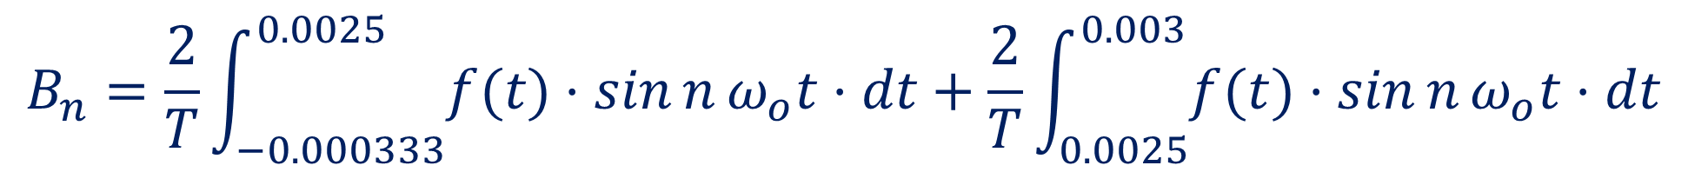
Thus A₁, A₂, A₃, A₄, A₅, A₆, …. can be determined.
B₁, B₂, B₃, B₄, B₅, B₆, …. can be determined.
Fourier Series of waveform can then be determined.
Remaining calculations are left to reader as an exercise.
$$B_{n}=\frac{2}{T}\int_{−0.000333}^{0.0025}{f(t)⋅\sin{n}ω_{o}t⋅dt}+\frac{2}{T}\int_{0.0025}^{0.003}{f(t)⋅\sin{n}ω_{o}t⋅dt}$$
Notes:
Thus A1, A2, A3, A4, A5, A6, …. can be determined. Similarly B₁, B₂, B₃, B₄, B₅, B₆, …. can be determined. Fourier Series of waveform can then be determined.
The remaining calculations are left to reader as an exercise

Slide 55
Effective Value of a Periodic Waveform
Defined in terms of power dissipation
Same as the r.m.s. value of the waveform.
Since the periodic waveform may be defined as
Notes:
We know now how to determine the Fourier series of a given periodic waveform. We now need to define the effective value of the waveform.
As active power is the most important parameter, the effective value of a periodic waveform is defined in the same way as the rms value of a sinusoidal waveform.
Thus the effective value A effective is defined as the square root of the mean of the squared waveform.
Since the periodic waveform can be defined in terms of the Fourier series, the corresponding terms are made use of in the evaluation of the effective value.

Slide 56
From trigonometry, only square terms will give non-zero integrals.
Product terms will all give zero integrals.
Notes:
Using the expansion of the square of a sum is equal to the sum of the squares and twice the sum of the product terms, the effective value is determined.
.

Slide 57
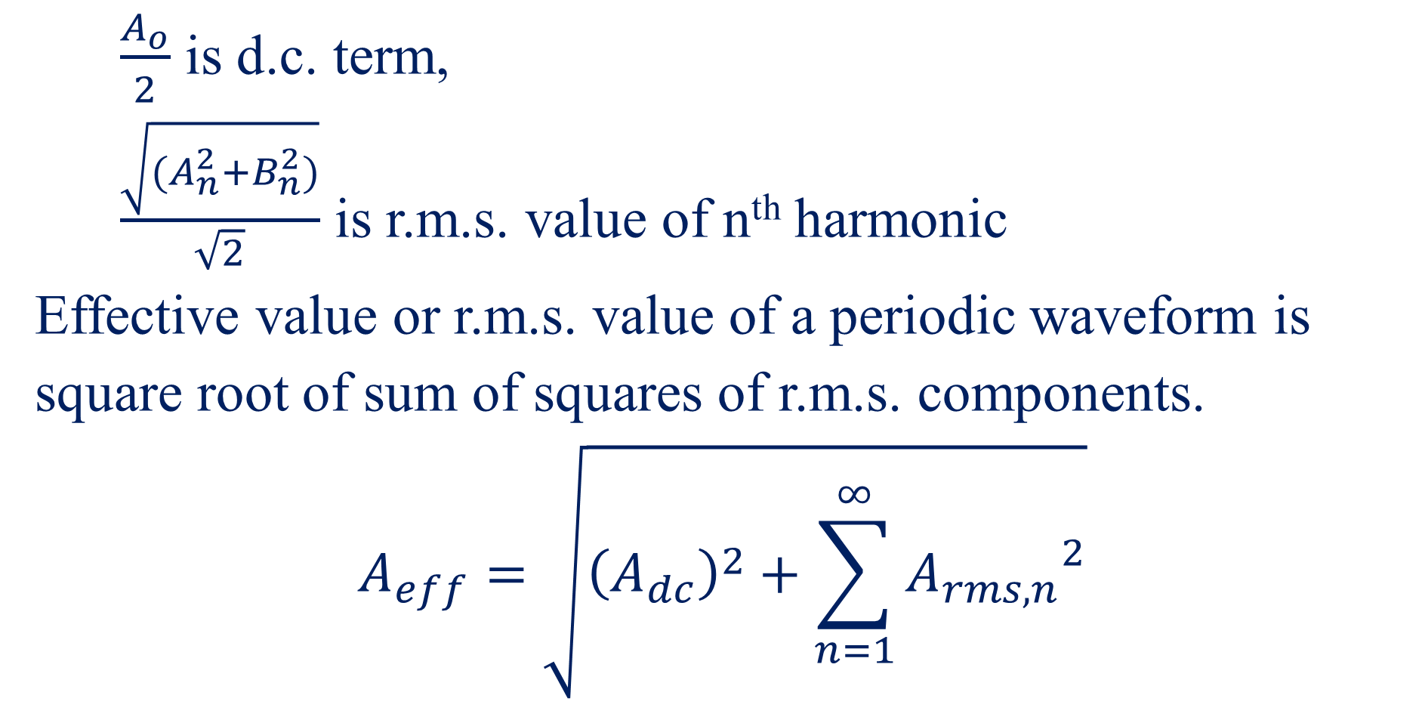
$\frac{A_{o}}{2}$ is d.c. term,
$\frac{\sqrt{(A_{n}^{2}+B_{n}^{2})}}{\sqrt{2}}$ is r.m.s. value of n^{th} harmonic
Effective value or r.m.s. value of a periodic waveform is
square root of sum of squares of r.m.s. components.
$$A_{eff}=\sqrt{{\left(A_{dc}\right)}^{2}+\sum_{n=1}^{∞}{{A_{rms,n}}^{2}}}$$
Notes:
The effective value is thus works out as the square root of the sum of the squares of the direct term and the harmonic terms

Slide 58
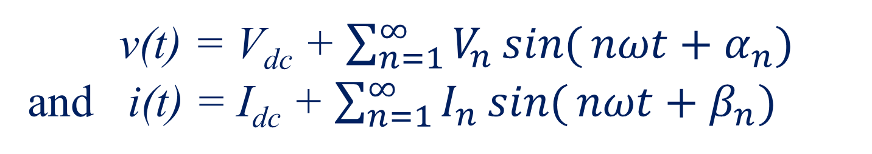
Calculation of Power and Power Factor associated with Periodic Waveforms
v(t) = V_{dc} + $\sum_{n=1}^{∞}{V_{n}\sin{(}nωt+α_{n})}$
and i(t) = I_{dc} + $\sum_{n=1}^{∞}{I_{n}\sin{(}nωt+β_{n})}$
p(t) = v(t).i(t)
average power P is given by
Notes:
Let us now see how the power and power factor may be evaluated when non-sinusoidal periodic waveforms are involved.
If v(t) has the Fourier series Vdc plus sigma Vn sin n omega t plus alpha n from n equals 1 to infinity, and i(t) has the Fourier series Idc plus sigma In sin n omega t plus beta n from n equals 1 to infinity,
Then the active power p(t) is given by v(t) times i(t), and the average power is given by
P = one over T integral from t zero to t zero plus capital T, v(t) times i(t) dt
Expressions for v(t) and i(t) are next substituted and the product expanded

Slide 59
Using trigonometric properties, only similar terms from v(t) and i(t) can give rise to non-zero integrals.
P = V_{dc}.I_{dc} + Σ ½V_{n} I_{n} cos(α _{n} - β _{n})
= V_{dc}.I_{dc} + Σ V_{rms,n} I_{rms,n} cosφ _{n}
Total power is given as sum of the powers of the individual harmonics including the fundamental and the direct term.
Notes:
Using trigonometric properties, only similar terms from v(t) and i(t) can give rise to non-zero integrals.
Thus P = V_{dc}.I_{dc} + σιγμα half V_{n} I_{n} cos(αλπηα _{n} - βετα _{n})
= V_{dc}.I_{dc} + σιγμα V_{rms,n} I_{rms,n} cosφ _{n}
The total active power is given as sum of the active powers of the individual harmonics including the fundamental and the direct term.

Slide 60
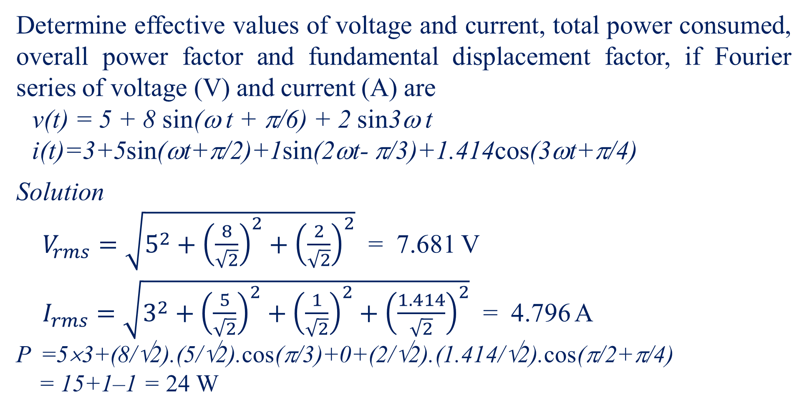
Example 6
Determine effective values of voltage and current, total power consumed, overall power factor and fundamental displacement factor, if Fourier series of voltage (V) and current (A) are
v(t) = 5 + 8 sin(ω t + π/6) + 2 sin3ω t
i(t)=3+5sin(ωt+π/2)+1sin(2ωt- π/3)+1.414cos(3ωt+π/4)
Solution
$V_{rms}=\sqrt{5^{2}+{\left(\frac{8}{\sqrt{2}}\right)}^{2}+{\left(\frac{2}{\sqrt{2}}\right)}^{2}}$ = 7.681 V
$I_{rms}=\sqrt{3^{2}+{\left(\frac{5}{\sqrt{2}}\right)}^{2}+{\left(\frac{1}{\sqrt{2}}\right)}^{2}+{\left(\frac{1.414}{\sqrt{2}}\right)}^{2}}$ = 4.796 A
P =5×3+(8/√2).(5/√2).cos(π/3)+0+(2/√2).(1.414/√2).cos(π/2+π/4)
= 15+1–1 = 24 W
Notes:
Let us now consider an example to determine the effective values of voltage and current, total power consumed, overall power factor and fundamental displacement factor, if Fourier series of voltage (V) and current (A) are
v(t) = 5 + 8 sin(ομεγα t + Πι/6) + 2 sin 3 ομεγα t
i(t)=3+5sin(ομεγα t+Πι/2)+1 sin(2 ομεγα t- Πι/3)+1.414cos(3 ομεγα t+Πι/4)
Vrms is calculated as square root of the sum of squares as shown giving 7.681V
Irms is similarly given as the square root of the sum of squares as 4.796 A
And active power P is given as the sum of the active powers as shown and given the result 24W.

Slide 61
Overall power factor
Overall power factor of a periodic waveform is defined as ratio of active power to apparent power.
Overall power factor =
Overall power factor = 24/(7.681 × 4.796) = 0.651
With non-sinusoidal waveforms, power factor is not associated with lead or lag as these no longer have any meaning.
Notes:
Let us now see how to calculate the overall power factor of a periodic waveform. As we already know, it is defined as ratio of active power to apparent power.
Thus in the example considered, the overall power factor is 24 divided by 7.681 times 4.796 or 0.651.
With non-sinusoidal waveforms, power factor is not associated with lead or lag as these no longer have any meaning.

Slide 62
Fundamental displacement factor
Fundamental displacement factor corresponds to power factor of the fundamental.
It tells by how much the fundamental component of current is displaced from the fundamental component of voltage, and hence is also associated with the terms lead and lag.
Fundamental displacement factor (FDF)
= cos φ₁ = cos (π/2 - π/6) = cos π/3 = 0.5 lead
Note that the term lead is used as the original current is leading the voltage by an angle π/3.
Notes:
Although the overall power factor does not have a lag or lead, the fundamental components of current and voltage will have a lag or lead. Thus Fundamental displacement factor is defined corresponding to the power factor of the fundamental.
It tells by how much the fundamental component of current is displaced from the fundamental component of voltage, and hence is also associated with the terms lead and lag.
Fundamental displacement factor (FDF) = cos πηι₁ = cos (Πι/2 - Πι/6) = cos Πι/3 = 0.5 lead in the example just considered.
Note that the term lead is used as the original current is leading the voltage by an angle Πι/3.

Slide 63
Analysis of Circuits in presence of Harmonics in Source
Due to presence of non-linear devices in the system, voltages and currents get distorted from sinusoidal.
Thus it becomes necessary to analyse circuits in the presence of distortion in source.
This can be done by using the Fourier Series of supply voltage and the principle of superposition.
For each frequency component, circuit is analysed, as for pure sinusoidal quantities, using normal complex number analysis, and the results are summed up to give the resultant waveform.
Notes:
Let us now see how Circuits can be analysed in the presence of Harmonics in the Source.
Due to presence of non-linear devices in the system, voltages and currents get distorted from sinusoidal.
Thus it becomes necessary to analyse circuits in the presence of a distortion in source.
This can be done by using the Fourier Series of the supply voltage and the principle of superposition.
For each frequency component, the circuit is analysed, as for pure sinusoidal quantities, using normal complex number analysis, and the results are summed up to give the resultant waveform.

Slide 64
Example 7
r = 10 Ω
L = 50mH
R = 100 Ω
e(t)
C = 100 μF
Determine voltage across load R for supply voltage e(t) applied to circuit shown in figure 22.
e(t) = 100 + 30 sin(300t + π/6) + 20 sin 900t
+ 15 sin (1500t - π/6) + 10 sin 2100t
Notes:
Let us consider an example to illustrate this.
For the circuit shown, determine the voltage across the load R for a supply voltage e(t) given by 100 + 30 sin(300t + Πι/6) + 20 sin 900t + 15 sin (1500t - Πι/6) + 10 sin 2100t

Slide 65
Solution
For the d.c. term,
. ∴V_{dc} = 90.91 V
For any a.c. term,
if V_{nm} is peak value of n^{th} harmonic of output voltage,
Notes:
Let us analyse with the dc term first, and then with the ac terms.
For the dc term, Vdc can be easily seen to be equal to 100 times 100 upon 110 or 90.91 V
For any ac term, if V_{nm} is the peak value of n^{th} harmonic of output voltage, using normal complex number theory but remembering that the angular frequency is n time omega, the general expression for Vnm is obtained in terms of Enm as shown.

Slide 66
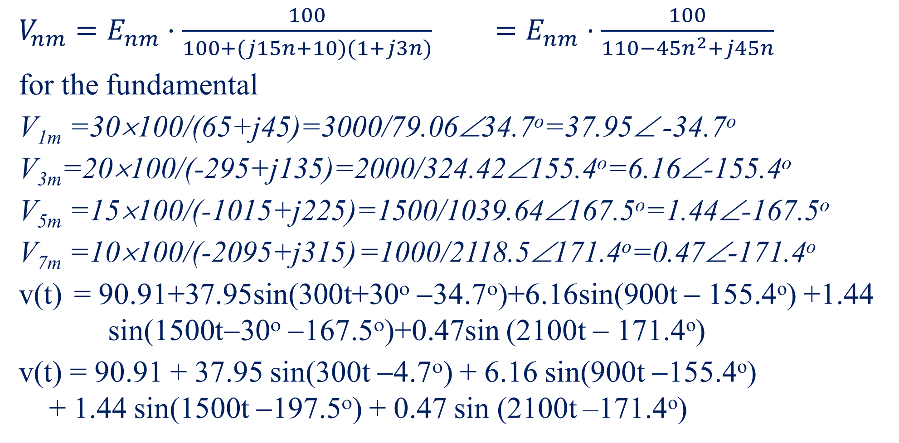
$V_{nm}=E_{nm}⋅\frac{100}{100+(j15n+10)(1+j3n)}$ $=E_{nm}⋅\frac{100}{110−45n^{2}+j45n}$
for the fundamental
V_{1m} =30×100/(65+j45)=3000/79.06∠34.7º=37.95∠ -34.7º
V_{3m}=20×100/(-295+j135)=2000/324.42∠155.4º=6.16∠-155.4º
V_{5m} =15×100/(-1015+j225)=1500/1039.64∠167.5º=1.44∠-167.5º
V_{7m} =10×100/(-2095+j315) =1000/2118.5∠171.4º=0.47∠-171.4º
v(t) = 90.91+37.95sin(300t+30^{ο} −34.7^{ο})+6.16sin(900t − 155.4º) +1.44 sin(1500t−30^{ο} −167.5^{ο})+0.47sin (2100t − 171.4º)
v(t) = 90.91 + 37.95 sin(300t −4.7^{ο}) + 6.16 sin(900t −155.4º)
+ 1.44 sin(1500t −197.5^{ο}) + 0.47 sin (2100t –171.4º)
Notes:
On simplification, Vnm works out to Enm times 100 over 110 minus 45 n squared + j 45 n
To determine the fundamental, substitute n=1, Similarly n=3, 5, 7 etc to obtain the harmonics.
Once these are obtained, v(t) may be obtained in the form of a Fourier series as shown.

Slide 67
Harmonic Analysis of Graphical Waveforms
Experimental waveforms, are known at discrete points,
not function of t.
Fourier coefficients need to be obtained graphically.
With discrete data, approximations are made.
Integrals used are replaced by finite summations.
If period T = 2π/ω is divided into N equal intervals Δt,
Notes:
Experimental waveforms, are known at discrete points, usually obtained digitally and not as a function of t.
In this case the Fourier coefficients need to be obtained from the graphically measured values
As the data is discrete, approximations need to be made to the Fourier series.
Integrals used are replaced by finite summations.
If period T, equalling 2Πι over omega, is divided into N equal intervals οφ δελτα t,
Delta t equals T over N equals 2 Pi over N omega
Substitution and simplification gives A zero equals 2 over N sigma fp of t, where fp is the magnitude at the pth instant of time.

Slide 68
similarly
Values of cos nω t_{p} and sin nω t_{p} calculated at mid interval.
Notes:
In like manner, the integrals for An and Bn can be converted to summations.
For higher accuracy in numerical integration, values of cos n ομεγα t_{p} and sin n ομεγα t_{p} are calculated at mid interval.
Also omega tp equals 2 Pi over N time p.

Slide 69
Example 8
Waveform obtained from a graph plotter which has been read off at 24 discrete intervals of time in one period.
Find fundamental and third-harmonic of half-wave symmetric waveform.
One half-cycle of waveform is defined as discrete ordinates as follows.
2π → 360º → 24 divisions,
1 div= 15º = θ
i(t)
t
Figure 23 – discrete waveform
p | 0 | 1 | 2 | 3 | 4 | 5 | 6 | 7 | 8 | 9 | 10 | 11 | 12
i(t_{p}) | 0 | 6.5 | 10.4 | 12.5 | 14.1 | 15.9 | 18.2 | 21.8 | 27.8 | 19.2 | 10 | 5 | 0
Notes:
Let us now consider an example of numerically determining the Fourier coefficients for a digitally given waveform. Since the waveform has half wave symmetry, only half the waveform needs to be defined.
In this example the period is divided into 24 intervals so that data is need at half these points. Also since 360 degrees is divided into 24 intervals, the spacing between data corresponds to 15 degrees.

Slide 70
Solution
Waveform has half-wave symmetry → no even harmonics
Integration (or summation) is done only over half a cycle.
It is seen that mean value of waveform is zero so that A_{o}/2 = 0.
Consider numerical evaluation of individual coefficients.
= (1/6).[6.5 cos 15º + 10.4 cos 30º + 12.5 cos 45º + 14.1 cos 60º + 15.9cos 75º +18.2cos 90º + 21.8cos 105º + 27.8cos 120º + 19.2 cos 135º + 10 cos 150º + 5 cos 165º +0 cos 180º]
= (1/6).(-11.32) = -1.89
Notes:
Waveform has half-wave symmetry so that no even harmonics are present. Integration (or summation) is done only over half a cycle.
It is seen that mean value of waveform is zero so that A_{o}/2 = 0.
Numerical evaluation of individual coefficients is shown.

Slide 71
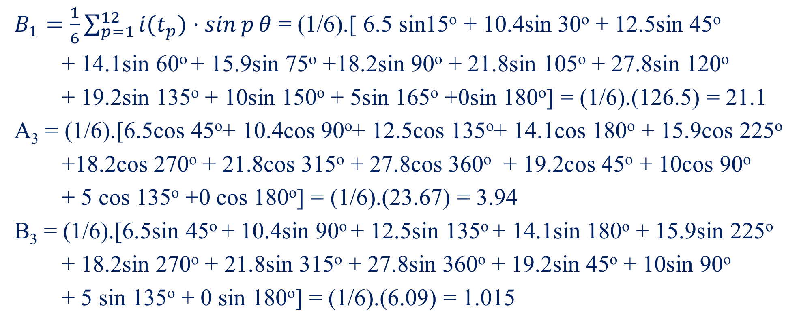
$B_{1}=\frac{1}{6}\sum_{p=1}^{12}{i(t_{p})⋅\sin{p}θ}$ = (1/6).[ 6.5 sin15º + 10.4sin 30º + 12.5sin 45º
+ 14.1sin 60º + 15.9sin 75º +18.2sin 90º + 21.8sin 105º + 27.8sin 120º
+ 19.2sin 135º + 10sin 150º + 5sin 165º +0sin 180º] = (1/6).(126.5) = 21.1
A₃ = (1/6).[6.5cos 45º+ 10.4cos 90º+ 12.5cos 135º+ 14.1cos 180º + 15.9cos 225º
+18.2cos 270º + 21.8cos 315º + 27.8cos 360º + 19.2cos 45º + 10cos 90º
+ 5 cos 135º +0 cos 180º] = (1/6).(23.67) = 3.94
B₃ = (1/6).[6.5sin 45º + 10.4sin 90º + 12.5sin 135º + 14.1sin 180º + 15.9sin 225º
+ 18.2sin 270º + 21.8sin 315º + 27.8sin 360º + 19.2sin 45º + 10sin 90º
+ 5 sin 135º + 0 sin 180º] = (1/6).(6.09) = 1.015
Determination of higher harmonics would not be accurate unless more points are defined on waveform.
Notes:
Since the number of data points is very limited, the determination of higher harmonics would not be accurate unless more points are defined on waveform.

Slide 72
∴ fundamental = −1.89 cos ωt + 21.1 sin ωt = 21.2 sin(ωt – 5.1º)
third harmonic=3.94 cos 3ωt +1.01 sin 3ωt =4.07sin(3ωt +75.6º)
In practical waveforms higher harmonics are generally smaller in amplitude.
If the fifth and higher harmonics are neglected,
i(t) = 21.2 sin(ωt – 5.1º) + 4.07 sin(3ωt +75.6º)
∴ Effective value =
= 15.26 A
Error caused would generally be only in the second decimal place in the above example.
Notes:
Using the fundamental and third harmonic determined, the effective value can be estimated. Much more data points and many harmonics would be necessary to obtain a realistic effective value.

Slide 73
Complex form of the Fourier Series
It would have been noted that the only frequency terms that were considered were positive frequency terms going up to infinity but that time was not limited to positive values.
Mathematically speaking, frequency can have negative values, but as will be obvious, negative frequency terms would have a corresponding positive frequency term giving the same Fourier component.
In the complex form, negative frequency terms are also defined.
Using the trigonometric expressions
e ^{jθ} = cos θ + j sin θ and e– ^{jθ} = cos θ – j sin θ
rewrite Fourier series.
Notes:
It would have been noted that the only frequency terms that were considered were positive frequency terms going up to infinity but that time was not limited to positive values.
Mathematically speaking, frequency can have negative values, but as will be obvious, negative frequency terms would have a corresponding positive frequency term giving the same Fourier component.
In the complex form, negative frequency terms are also defined.
Using the trigonometric expressions
E to the power j theta = cos τηετα + j sin τηετα and e to the power minus j theta = cos τηετα – j sin τηετα
Now the Fourier series may be written in complex form.

Slide 74
This can be re-written in the following form
It is to be noted that B_{o} is always 0, so that the j0 with A_{o} may be written as jB_{o}. Also e^{j0} = 1
Thus defining
,
Notes:
I will not explain the individual steps, but will leave it for you to figure out.
It must be noted that we now define a new term Cn which is half the sum of An and minus j Bn.

Slide 75
we have
and
the term on right hand side outside summation can be written as C_{o} e ^{j0} and first term inside summation becomes C_{n} e ^{jnω}_{º} ^{t}.
Since
,
= A_{n}
and
= -B_{n}
,
i.e. Second term inside summation becomes C_{-n} e⁻ ^{jnω}_{º} ^{t}.
Notes:
It can be easily seen that C zero corresponds to A zero by 2 and that C minus n corresponds to half the sum of An and j Bn

Slide 76
The three sets of terms in equations correspond to zero term, positive terms and negative terms of frequency.
Thus Fourier Series may be written in complex form as
and Fourier coefficient C_{n} can be calculated as follows.
Notes:
Combining terms, the Fourier series may be written in complex form as
f(t) equals sum from minus infinity to plus infinity of Cn e to the power of j n omega zero t
and the Fourier coefficient Cn can be calculated from one ove T integral t to t + capital T integral over a cycle of ft(t) time e to the power of –j n omega t times dt

Slide 77
The Fourier Series may be written in complex form as
where the Fourier coefficients C_{n} are given by
In symmetrical form,
Fourier series is written with t_{o} = −T/2.
Fourier series is written for a periodic function with period T,
and discrete frequency components are obtained for the waveform.
Fundamental frequency ω_{o} is related to period T by expression ω_{o} = 2π/T.
Notes:
Determination of the complex form of the Fourier series and the Fourier coefficients are shown.

Slide 78
End of Presentation

